Slide 1


Principal Component Analysis
==============================================================================================
WWW.THEMLLABS.COM || contact@themllabs.com || Phone : 91-7338339898, 91-6362546088

Slide 2


Agenda
What is PCA?
Steps Inlved in PCA
Applications of PCA
Mathematical Illustration
Coding PCA in python
What is PCA?
Steps Involved in PCA
Applications of PCA
Mathematical Illustration
Coding PCA in python
==============================================================================================
WWW.THEMLLABS.COM || contact@themllabs.com || Phone : 91-7338339898, 91-6362546088

Slide 3
What is PCA?
What is PCA?
Steps Inlved in PCA
Applications of PCA
Mathematical Illustration
Coding PCA in python
It is a dimensionality-reduction method
It reduces the larger data sets into smaller one by reducing the number of variables
Still retains most of the information.
Trade off for accuracy, as the no. of variables are reduced.
Simple to use for Machine Learning algorithms
==============================================================================================
WWW.THEMLLABS.COM || contact@themllabs.com || Phone : 91-7338339898, 91-6362546088

Slide 4
Steps involved in PCA
What is PCA?
Steps Inlved in PCA
Applications of PCA
Mathematical Illustration
Coding PCA in python
Standardization
Covariance Matrix Computation
Computation Of The Eigenvectors And Eigenvalues Of The Covariance Matrix
Identification Of Principal Components
Feature Vector
Recast the data along the principal components axes
Feature Vector
Recast the data along the principal components axes
==============================================================================================
WWW.THEMLLABS.COM || contact@themllabs.com || Phone : 91-7338339898, 91-6362546088

Slide 5
Standardization
What is PCA?
Steps Inlved in PCA
Applications of PCA
Mathematical Illustration
Coding PCA in python
Standardize the range of the continuous initial variables so that each one of them contributes equally to the analysis.
Why Standardization?
To avoid biased results
large differences between the ranges of initial variables will dominate over those with small ranges
Example - a variable that ranges between 0 and 100 will dominate over a variable that ranges between 0 and 1
To avoid this transform the data to comparable scales
==============================================================================================
WWW.THEMLLABS.COM || contact@themllabs.com || Phone : 91-7338339898, 91-6362546088

Slide 6

Cont..
Tansform the data to comparable scales using the following equation
After transformation all the variables will be in the same scale
==============================================================================================
WWW.THEMLLABS.COM || contact@themllabs.com || Phone : 91-7338339898, 91-6362546088

Slide 7
Covariance Matrix Computation
It gives the understanding of how the variables in the input data set are varying from the mean, with respect to each other.
Identifies the Highly redundant information – Highly correlated
To identify correlations – Compute Co variance Matrix
covariance of a variable with itself is nothing but variance
(Cov(a,a)=Var(a))
==============================================================================================
WWW.THEMLLABS.COM || contact@themllabs.com || Phone : 91-7338339898, 91-6362546088

Slide 8
Covariance Matrix Computation (cont..)
What do we understand from covariance?
Significance lies in the Sign.
+ve 🡪 the two variables increase or decrease together (correlated)
- Ve 🡪 One increases when the other decreases (Inversely correlated)
Covariance Matrix 🡪 correlations between all the possible pairs of variables
==============================================================================================
WWW.THEMLLABS.COM || contact@themllabs.com || Phone : 91-7338339898, 91-6362546088

Slide 9
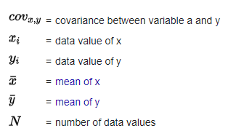

Covariance Matrix Computation (cont..)
Covariance Matrix is symmetric with dimensions pxp
Where p is the number of variables.
Consider a 3-Dimensional data set with vaiables (x,y,z).
Covariance Matrix
==============================================================================================
WWW.THEMLLABS.COM || contact@themllabs.com || Phone : 91-7338339898, 91-6362546088

Slide 10
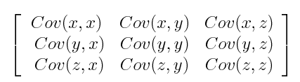
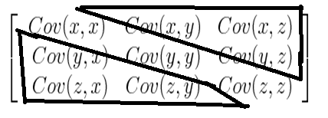
Covariance Matrix Computation (cont..)
Covariance Matrix
covariance satisfies commutative property (Cov(a,b)=Cov(b,a)),
Therefore with respect to main diagonal the upper and lower triangular portions are equal
==============================================================================================
WWW.THEMLLABS.COM || contact@themllabs.com || Phone : 91-7338339898, 91-6362546088

Slide 11
Computation Of The Eigenvectors And Eigenvalues Of The Covariance Matrix
Eigen vector is the projected vector from the data which is perpendicular to the data.
They are generally projected in the direction of most significant data.
Eigen vectors are generally column vectors
Eigen values and Eigen vectors are computed from covariance matrix to determine the principal components.
the eigenvectors are ordered by their eigen values in descending order, -- this helps in find the principal components in the order of significance.
The Eigen vector with the highest eigen value is the principle component
==============================================================================================
WWW.THEMLLABS.COM || contact@themllabs.com || Phone : 91-7338339898, 91-6362546088

Slide 12
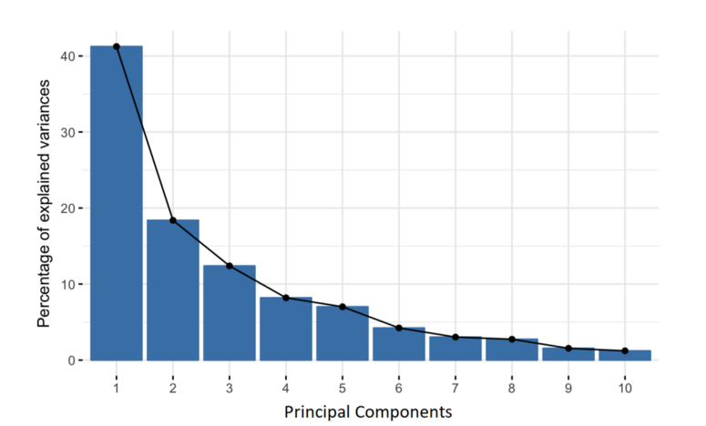
Computation Of The Eigenvectors And Eigenvalues Of The Covariance Matrix
Constructed in such a way that the resultant is uncorrelated
Most of the information within the initial variables is compressed into the first components.
If a 10 dimensional data produces 10 principal components then PCA gives maximum information in the first component and remaining information in the other components and so on..
First principal component -- largest possible variance in the data set
Second principal component -- next highest variance(uncorrelated with the first principal component)
==============================================================================================
WWW.THEMLLABS.COM || contact@themllabs.com || Phone : 91-7338339898, 91-6362546088

Slide 13
Feature vector
From the ordered Eigen vectors - choose whether to keep all these components or discard those of lesser significance (of low eigenvalues)
The remaining matrix of Eigen vectors is called Feature Vector.
Feature vector is simply a matrix that has as columns the eigenvectors of the components that we decide to keep.
if we choose to keep only p eigenvectors out of n, the final data set will have only p dimensions
==============================================================================================
WWW.THEMLLABS.COM || contact@themllabs.com || Phone : 91-7338339898, 91-6362546088

Slide 14
RECAST THE DATA ALONG THE PRINCIPAL COMPONENTS AXES
Use the feature vectors, to reorient the data from the original axes to the ones represented by the principal components (hence the name Principal Components Analysis).
This can be done by multiplying the transpose of the original data set by the transpose of the feature vector.
==============================================================================================
WWW.THEMLLABS.COM || contact@themllabs.com || Phone : 91-7338339898, 91-6362546088

Slide 15
Cont..
row feature vector - data
Row data adjust: - eigen vector
Multiply the row feature vector into the row data adjust.
In the result each and every data is converted into the principle component.
Getting the original data back:
Row original data = (Row feature vector ^{T} x Final Data )+ original Mean
==============================================================================================
WWW.THEMLLABS.COM || contact@themllabs.com || Phone : 91-7338339898, 91-6362546088

Slide 16
Applications of PCA
Data Visualization
Speeding Machine Learning (ML) Algorithm
==============================================================================================
WWW.THEMLLABS.COM || contact@themllabs.com || Phone : 91-7338339898, 91-6362546088

Slide 17
Mathematical illustration
Consider the following data set
x | 2.5 | 0.5 | 2.2 | 1.9 | 3.1 | 2.3 | 2 | 1 | 1.5 | 1.1
y | 2.4 | 0.7 | 2.9 | 2.2 | 3 | 2.7 | 1..6 | 1.1 | 1.6 | 0.9
Shifting the data points towards origin by subtracting from mean
x | 0.69 | -1.31 | 0.39 | 0.09 | 1.29 | 0.49 | 0.19 | -0.81 | -0.31 | -0.71
y | 0.49 | -1.21 | 0.99 | 0.29 | 1.09 | 0.79 | -0.31 | -0.81 | -0.31 | -1.01
==============================================================================================
WWW.THEMLLABS.COM || contact@themllabs.com || Phone : 91-7338339898, 91-6362546088

Slide 18
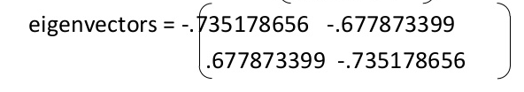
Mathematical illustration
Covariance Matrix =
[0.61655556 0.61544444]
[0.61544444 0.71655556]]
Since the non diagonal elements in this covariance matrix are positive , x and Y variables will increase together
Calculation of Eigen values and Eigen vectors
Eigen Values
[0.0490834 1.28402771]
==============================================================================================
WWW.THEMLLABS.COM || contact@themllabs.com || Phone : 91-7338339898, 91-6362546088

Slide 19
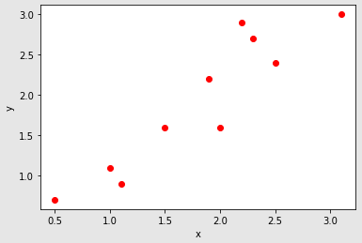
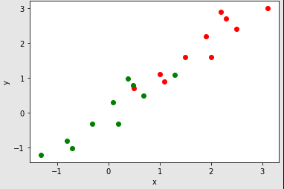
Mathematical illustration
Raw data set
Data set Translated to origin
==============================================================================================
WWW.THEMLLABS.COM || contact@themllabs.com || Phone : 91-7338339898, 91-6362546088

Slide 20




Mathematical illustration
Sorted Eigen Values and Eigen Vectors
Feature Vector
n=1
n=2
==============================================================================================
WWW.THEMLLABS.COM || contact@themllabs.com || Phone : 91-7338339898, 91-6362546088

Slide 21
Mathematical illustration
Final data
For n=1
[0.82797019]
[-1.77758033]
[ 0.99219749]
[ 0.27421042]
[ 1.67580142]
[ 0.9129491 ]
[-0.09910944]
[-1.14457216]
[-0.43804614]
[-1.22382056]
n=2
[0.82797019 -0.17511531]
[-1.77758033 0.14285723]
[ 0.99219749 0.38437499]
[ 0.27421042 0.13041721]
[ 1.67580142 -0.20949846]
[ 0.9129491 0.17528244]
[-0.09910944 -0.3498247 ]
[-1.14457216 0.04641726]
[-0.43804614 0.01776463]
==============================================================================================
WWW.THEMLLABS.COM || contact@themllabs.com || Phone : 91-7338339898, 91-6362546088

Slide 22
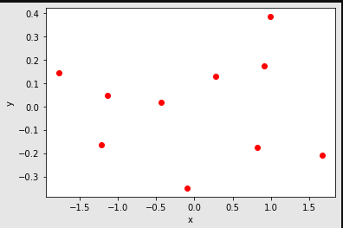
Final data
==============================================================================================
WWW.THEMLLABS.COM || contact@themllabs.com || Phone : 91-7338339898, 91-6362546088

